Slide 1
Chernobyl Defuse The Container Project
By: Joseph, Volodymyr, Sebastian

Slide 2
01
Unique Implementation

Slide 3
Uniqueness
Phase Structure

Slide 4
Uniqueness
Phase Structure
Serial Number Calculations

Slide 5
Uniqueness
Phase Structure
Serial Number Calculations
Dynamic Button

Slide 6
Uniqueness
Phase Structure
RSA Encryption
Serial Number Calculations
Dynamic Button

Slide 7
Uniqueness
Phase Structure
RSA Encryption
Wires Binary Puzzle
Serial Number Calculations
Dynamic Button

Slide 8
Uniqueness
Phase Structure
RSA Encryption
Wires Binary Puzzle
Serial Number Calculations
Dynamic Button
Additional GUI Implementations

Slide 9
02
Project Overview

Slide 10
Into Account For Defusal
Toggles
Keypad
Defusal
Button
Wires

Slide 11
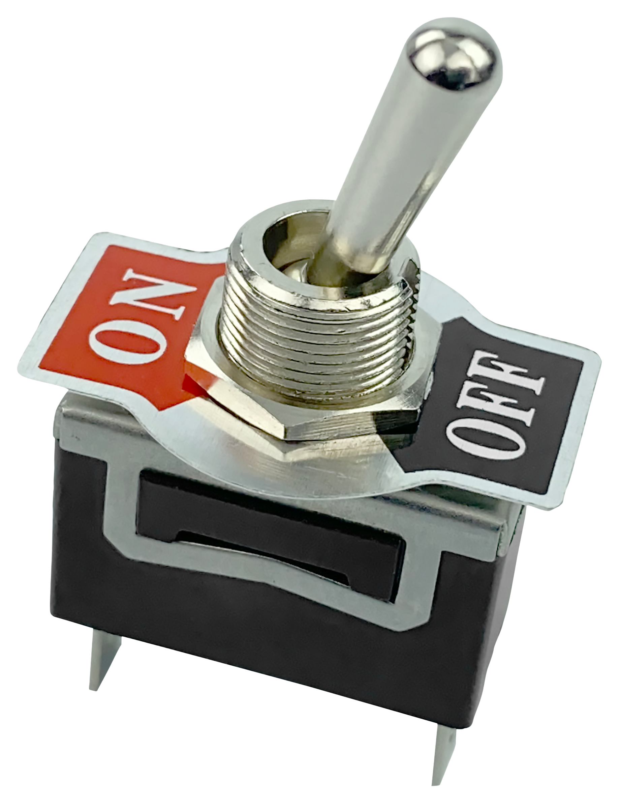
Toggles Part 1
Find numerical digits withing the serial number
Sum them
Convert them to binary
Flip the Toggles

Slide 12
Toggles Part 2
Find Letters within the serial number
Sum them
Convert them to binary
Flip the Toggles

Slide 13

Button
Button Starts Red or Green Randomly
Don’t let it stay Red for too long press it to turn green.
Always keep the Button Green

Slide 14
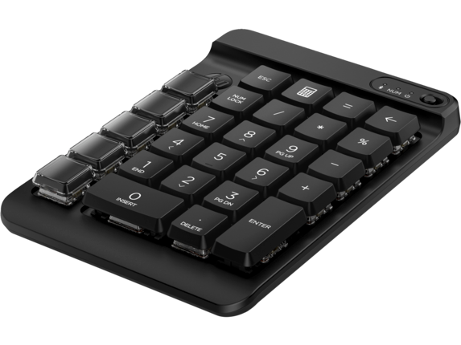
Keypad
Record the defuse keywords and keys
Convert and enter these into the RSA tab
If correct, a keyword will appear
Enter the keyword on the tab

Slide 15
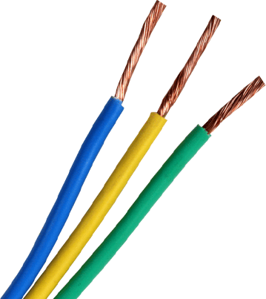
Wires
Use the letter provided after the keypad is defused
Use the dictionary provided and based on the letter disconnect the wires

Slide 16
Future Plans
Radiation Sickness
Make it Less Difficult
Increase the blur of the screen as radiation increases
Screen blacking out
Add meme images
Add funny sounds

Slide 17
Lessons Learned
01
Critical Thinking

Slide 18
Lessons Learned
01
02
Critical Thinking
Teamwork

Slide 19
Lessons Learned
01
03
02
Critical Thinking
Time Management
Teamwork

Slide 20
Lessons Learned
01
03
02
04
Critical Thinking
Time Management
Teamwork
Patience and Organization

Slide 21
Redesigns
Different Themes

Slide 22
Redesigns
Different Themes
Adjustable Difficulty

Slide 23
Redesigns
Different Themes
Adjustable Difficulty
Add Leaderboards

Slide 24
Redesigns
Different Themes
Adjustable Difficulty
Add Leaderboards
Pop up image after strike

Slide 25
Thank You!

